Slide 1

MINI PROJECT
Knee Surgery Innovation: Enhancing Precision and Patient Care

Slide 2
BATCH D9
PRESENTED BY :
TAMIL SELVI A - 211422104511
VIJAYASANKARI V - 211422104543
PROJECT CO-ORDINATOR : Dr. T. TAMILVIZHI
DOMAIN : AUGMENTED REALITY / VIRTUAL REALITY

Slide 3
ABSTRACT
The integration of Augmented Reality (AR) and Virtual Reality (VR) into medical training and surgery has revolutionized orthopedic practices, particularly in knee surgery. AR/VR technologies offer immersive, 3D simulations that enhance both preoperative planning and intraoperative guidance. This abstract explores the use of AR/VR in knee surgery, highlighting its potential to improve surgical precision, reduce complications, and provide real-time anatomical visualization. AR overlays can be used during surgery to project critical data such as bone structure, ligament positions, and implant placements directly onto the operative field, aiding surgeons in making more informed decisions. VR platforms, on the other hand, allow for detailed simulations, enabling surgeons to practice procedures in a risk-free, virtual environment. This technology can also be used for patient education, allowing individuals to visualize their specific condition and understand the planned surgical intervention.

Slide 4
OBJECTIVES
To demonstrate AR/VR-assisted ACL reconstruction surgery
Showcase how augmented and virtual reality technologies can aid surgeons in performing ACL reconstruction with enhanced precision.
To improve surgical training through AR/VR
Highlight the role of immersive AR/VR simulations in providing better training for surgeons by creating a realistic, risk-free environment for practice.
To enhance intraoperative guidance and accuracy
Explore the integration of AR/VR tools to improve real-time visualization, accuracy, and decision-making during ACL reconstruction procedures.
To minimize recovery time and post-surgical complications
Investigate how precise AR/VR-guided procedures may reduce patient recovery time and the risk of complications by improving surgical outcomes.

Slide 5
Problem Statement:
Traditional ACL reconstruction procedures rely heavily on the surgeon's experience and intraoperative imaging tools, which can be limited in providing real-time, precise visualization. This may lead to inaccuracies in graft placement, longer surgical times, and higher risks of post-operative complications such as graft failure or improper alignment. Additionally, surgical training often lacks immersive, hands-on practice in complex procedures like ACL reconstruction, affecting skill development in trainees.
Solution:
By integrating Augmented Reality (AR) and Virtual Reality (VR) technologies into ACL reconstruction procedures, surgeons can benefit from enhanced real-time visualization, precise graft positioning, and interactive guidance throughout the surgery. AR/VR can also serve as an advanced training tool, offering immersive simulations for practicing surgeons, allowing them to refine their skills in a controlled, risk-free environment. This approach aims to improve surgical accuracy, reduce operation time, and enhance both patient outcomes and surgeon proficiency.

Slide 6
LITERATURE SURVEY
S.no | TITLE | AUTHOR NAME & YEAR | DESCRIPTION
1 | Procedure for the implementation of VR/AR learning scenarios for method training - Presentation of the Assisted Reality Implementation Model (ARIM) | Amelie Karcher, Dominik Arnold, Christopher Prinz, Bernd Kuhlenkötter, 2022 | The model aims to create standardized, immersive, and efficient virtual training environments, promoting sustainable knowledge transfer and practical application of complex quality methods. ARIM follows the ADDIE framework, with phases for analysis, design, and validation, ensuring that VR/AR technologies are effectively integrated into training programs. The paper also emphasizes the importance of interactive and user-centered learning experiences enabled by VR/AR systems, which offer flexible, resource-saving, and safe environments for professional development
2 | Surgical Navigation Systems Based On AR/VR Technologies | Vladimir Ivanov, Anton Krivtsov, Sergey, Strelkov, Dmitry Gulyaev,Denis Godanyuk Nikolay Kalakutsky, Artyom Pavlov, Marina Petropavloskaya, Alexander Smirnov, Andrey Yaremenko, 2021 | The paper discusses the development and application of augmented reality (AR) and virtual reality (VR) technologies in surgical navigation. These systems allow surgeons to visualize 3D holograms of patient organs, created from MRI and CT data, providing real-time guidance during surgeries. The paper highlights the use of these technologies in neurosurgery and spinal surgery, demonstrating reduced invasiveness and improved precision.
3 | A virtual reality classroom to teach and explore crystal solid state structures | Erica Stella1 · Isabella Agosti1 · Nicoletta Di Blas1 · Marco Finazzi1 · Pier Luca Lanzi1 · Daniele Loiacono1, 2020 | The paper presents an educational virtual reality (VR) application designed to teach crystallography. It allows teachers to give lectures in a shared virtual environment and record these for later review. The application helps students understand complex crystal structures by providing interactive 3D visualization. It supports remote learning and self-study, letting students explore crystal structures independently. The system is validated through user feedback, showing its potential to improve the comprehension of crystal solid-state concepts

Slide 7
LITERATURE SURVEY
S.NO | TITLE | AUTHOR NAME & YEAR | DESCRIPTION
4 | Virtual Reality Application for the Safety Improvement of Intralogistics Systems | Konrad Lewczuk, Patryk Z˙ uchowicz, 2024 | The paper explores the integration of Virtual Reality (VR) in enhancing the safety of intralogistics environments, such as warehouses and production facilities. It focuses on how VR can support design, testing, and employee training processes to improve occupational and functional safety. The study reviews literature on VR applications in industrial safety and proposes a framework using the FlexSim simulation environment for conducting VR-based safety analysis
5 | Augmented and Virtual Reality Usage in Awake Craniotomy: A Systematic Review | Mohammad Sadegh Mashayekhi,Saman Arfaie,Yimin Chen, Asfand,Baig Mirza, Jawad Fares, 2022 | This systematic review explores the applications of augmented reality (AR) and virtual reality (VR) in awake craniotomy (AC), analyzing six studies involving 118 patients. The findings indicate that VR was predominantly used for intraoperative mapping of language, vision, and social cognition, while AR facilitated preoperative training and intraoperative visualization. The majority of cases involved brain tumors, and overall satisfaction was reported by both patients and surgeons regarding the use of these technologies. Notably, VR enabled innovative assessments of visual fields and social cognition during surgery, while AR reduced workflow interruptions compared to traditional navigation methods. The authors conclude that AR and VR can effectively enhance various phases of AC, suggesting a promising future for these technologies in neurosurgery, although further research is warranted to fully evaluate their potential.

Slide 8
EXISITING SYSTEM
Surgeons perform ACL reconstruction procedures using traditional methods, relying on their expertise and experience, often supported by standard imaging tools such as X-rays or MRI scans.
Intraoperative imaging provides limited, 2D visualization, making it challenging to accurately assess complex anatomical structures and achieve precise graft placement
Surgical trainees learn through observation, static models, or cadaver dissections, which lack the dynamic, interactive experience needed for complex surgeries like ACL reconstruction.
The reliance on experience and limited real-time guidance increases the likelihood of graft misplacement, increased surgery time, and post-operative complications such as graft failure or improper ligament alignment.

Slide 9
PROPOSED SYSTEM
(AR/VR-Guided ACL Reconstruction)
AR/VR-Assisted Visualization: Use augmented and virtual reality to provide surgeons with 3D, real-time, and immersive visualization of the knee joint during surgery, improving the accuracy of graft placement.
Interactive Guidance: AR overlays and VR simulations offer step-by-step guidance throughout the surgery, ensuring precision and reducing the margin for error.
Enhanced Surgical Training: Trainees can practice ACL reconstruction in a fully immersive, simulated environment using VR, allowing for hands-on learning without risk to patients.
Improved Outcomes: With better real-time visualization and interactive guidance, the AR/VR system aims to reduce surgical time, minimize post-surgical complications, and enhance overall patient recovery and satisfaction.

Slide 10
HARDWARE & SOFTWARE REQUIREMENTS
HARDWARE :
Head Mounted Displays
Computer Workstation/ Server
3D Motion Controllers
Display Monitors
SOFTWARE:
Unreal Engine Development Platform
Blender 3D Modeling Software

Slide 11
MODULES
Training Module:
This module provides functionalities specifically designed for training surgeons in ACL reconstruction.
VR Surgical Simulations: Trainees can practice ACL reconstruction in a fully immersive virtual reality environment, allowing them to experience the procedure without risk to patients.
Scenario-Based Learning: Multiple scenarios can be created, simulating different patient anatomies and surgical challenges (e.g., varying degrees of ligament damage), enabling trainees to develop problem-solving skills.
Interactive Tutorials: Step-by-step guided tutorials within the VR environment help trainees learn the surgical techniques, instrument handling, and procedural workflow.

Slide 12
MODULES
Assessment Module:
This module evaluates the performance and progress of trainees during the training sessions.
Real-Time Performance Tracking: The system tracks key performance indicators (KPIs) such as precision, timing, and technique during VR simulations, providing immediate feedback to trainees.
Post-Simulation Assessments: After completing a simulation, trainees receive a detailed performance report highlighting strengths and areas for improvement.
Competency Levels: Trainees can achieve different competency levels based on their performance, helping to guide their training paths and progress

Slide 13
MODULES
Feedback and Review Module:
This module focuses on gathering and providing feedback from and to the trainees.
Surgeon Feedback Integration: Experienced surgeons can review trainee performances and provide constructive feedback, enhancing the learning experience.
Peer Review System: Trainees can participate in peer reviews, discussing techniques and sharing insights on challenges faced during simulations.
Continuous Improvement: The feedback collected helps in refining the training modules and scenarios, ensuring they remain relevant and effective for skill development.

Slide 14
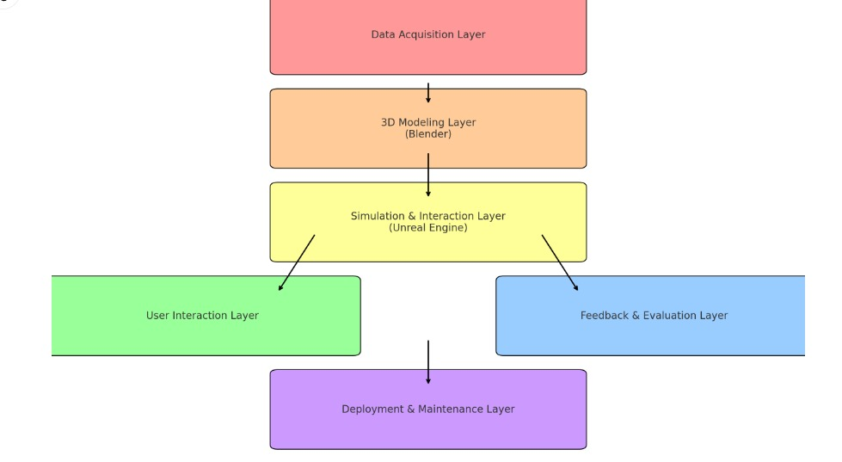
ARCHITECTURE
DIAGRAM

Slide 15
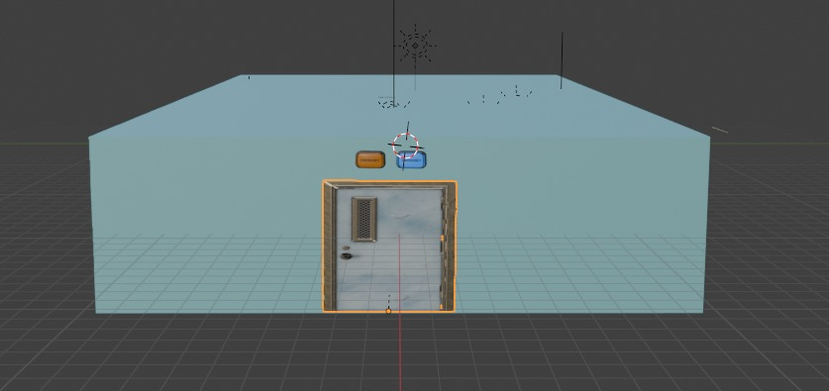
SAMPLE SREENSHOTS
1. EXTERIOR VIEW OF THE VIRTUAL SURGERY ROOM

Slide 16
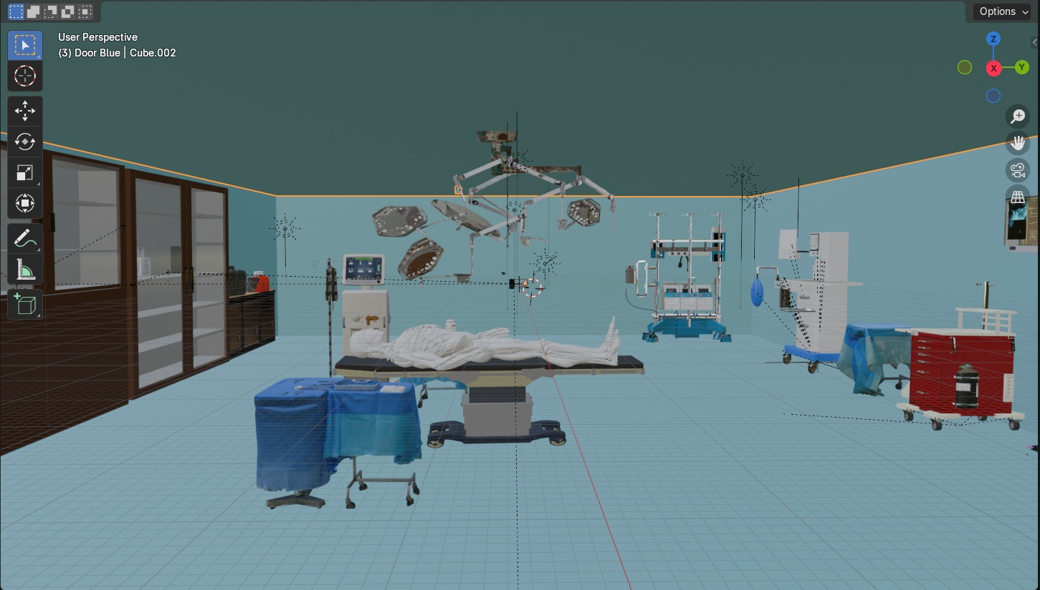
2. INTERIOR VIEW OF THE VIRTUAL SURGERY ROOM

Slide 17
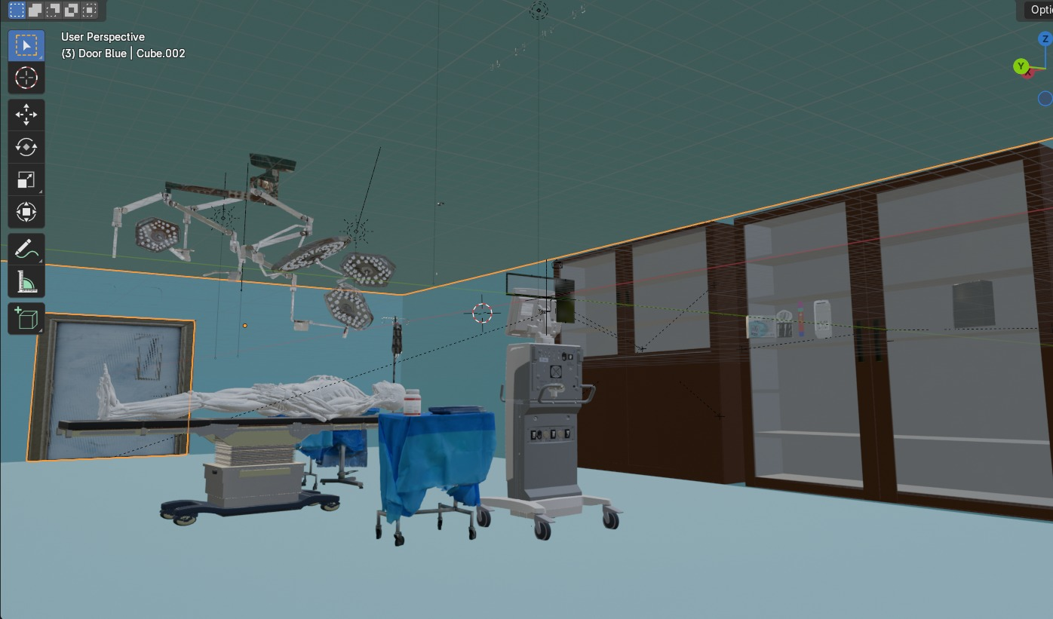
3. INTERIOR VIEW

Slide 18
CHALLENGES
Technical Complexity:
Ensuring real-time performance and synchronization between AR/VR visuals and real-world surgical movements can be challenging.
User Acceptance:
Surgeons and medical trainees may be hesitant to adopt new technologies, especially in critical procedures like ACL reconstruction.
Cost and Resource Allocation:
The initial investment in AR/VR hardware, software development, and ongoing maintenance can be significant.
Data Privacy and Security:.
Ensuring data integrity and protecting against breaches is crucial.
Realism and Immersion:
Creating realistic simulations that accurately reflect surgical procedures and anatomical variations is a complex task.

Slide 19
ADVANTAGES
Enhanced Learning Experience:
Trainees can repeatedly practice scenarios to build confidence and improve skills without the pressure of real surgeries.
Patient-Specific Training:
Trainees can learn to handle diverse surgical challenges and anatomical variations.
Cost-Effectiveness in Training:
Once established, an AR/VR training program can reduce costs associated with traditional training methods, such as cadaver use and operating room time.
Scalability:
The AR/VR system can be scaled to train multiple users simultaneously, accommodating a larger number of trainees and facilitating wider access to advanced training methods.
Improved Surgical Outcomes:
By enhancing training quality and preparedness, the AR/VR system can lead to better surgical techniques and improved patient outcomes in real-life surgeries.

Slide 20
FUTURE ENHANCEMENTS
Advanced Simulation Features:
Realistic tissue simulation with haptic feedback.
Dynamic scenarios that adapt to trainee actions.
AI and Machine Learning Integration:
AI-driven performance analysis for personalized feedback.
Smart scenario generation based on skill level.
Expanded Training Modules:
Multi-specialty training for other orthopedic procedures.
Post-surgery rehabilitation training modules..
Improved User Experience:
Customizable avatars for increased engagement.
User-friendly interface for accessibility.

Slide 21
CONCLUSION
The AR/VR-guided ACL reconstruction training project represents a transformative approach to surgical education, leveraging cutting-edge technology to enhance training experiences for surgeons. By providing immersive, realistic simulations and personalized feedback, this project aims to improve skill acquisition and confidence among trainees. As we continue to refine the system and incorporate future enhancements, we will contribute to better surgical outcomes and patient care in the field of orthopedic surgery.

Slide 22
THANK YOU

